Slide 1
Carina
Collaborative Solar Imaging Annotation
Sponsor/Mentor:
Dr. Marios Pattichis
Team Members:
Patrick Lopez, Jaclynn Wakley, Edward Sadzewicz,
Cody Shell, Connor Dolan

Slide 2
Introduction
The objective of this project is to provide a collaborative internet application in which users will be able to annotate solar observational images.
Notes:
The objective of this project is to provide a collaborative internet application in which users will be able to annotate solar observational images. The CARINA (CollAboRative Image aNnotAtion) web app will allow users to create data points along the perimeter of coronal holes in the images. The annotated data will be joined with its respective image and made available for further analysis by the image provider.

Slide 3


Motivation
The motivation driving the project are concerns of coronal mass ejections on:
Spacecraft
Critical satellite operations (like GPS)
Radio communications
Power grid
Notes:
The motivation driving the project are concerns of
space weather generated by solar activity and its impacts, which can cause significant damage to spacecraft, critical satellite operates (like GPS), radio communications, and the power grid. The data from this project will improve space weather prediction capabilities.

Slide 4
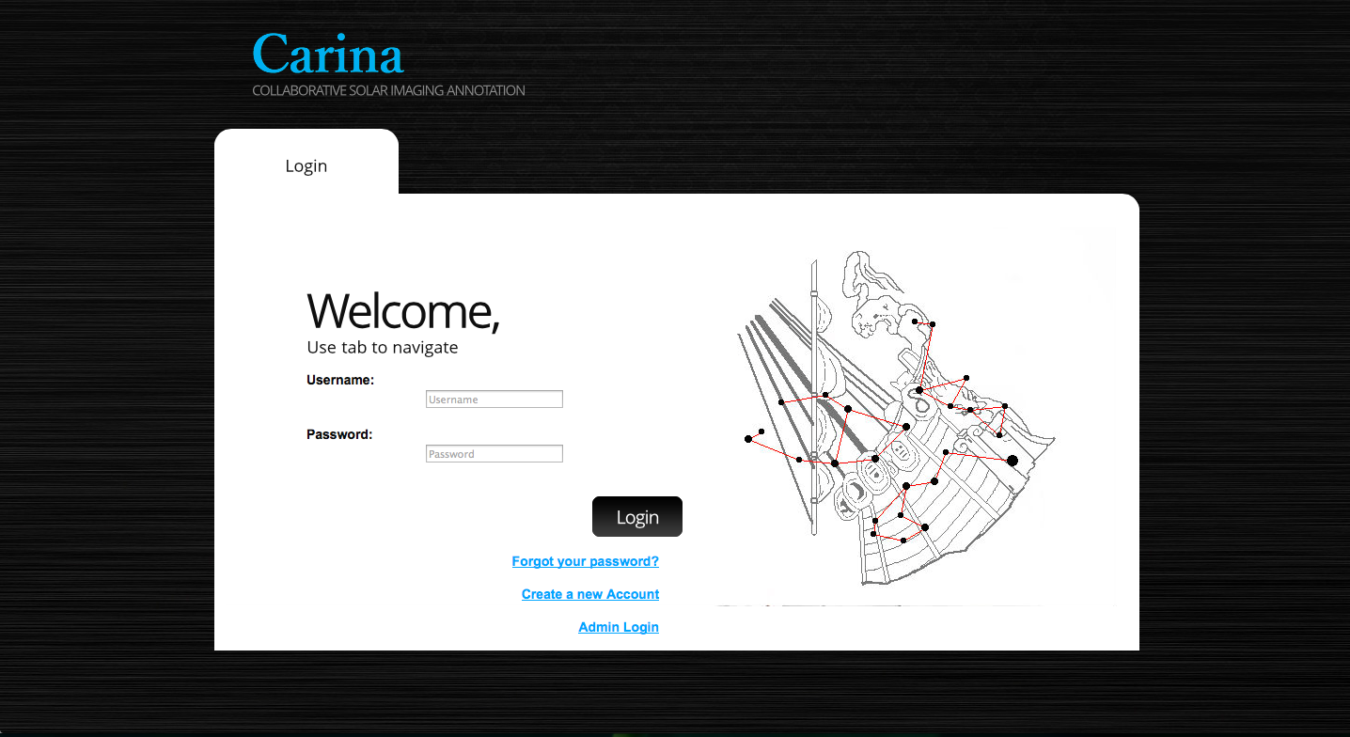
Product Functions
Users will be able to make an account and log into the site where they can securely view their personal solar annotation data.

Slide 5
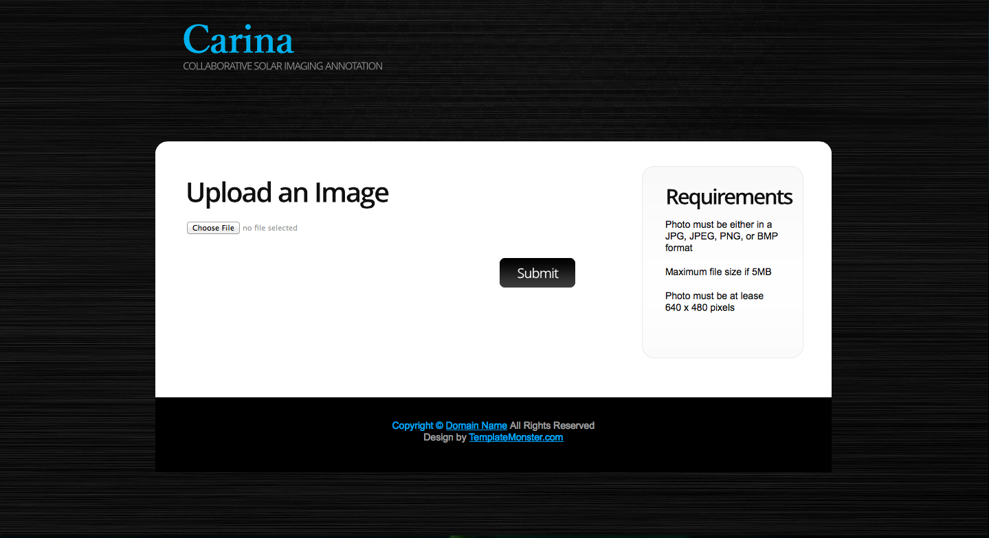
Product Functions
The web app will allow the user to choose an image from their local computer and upload it to the database for annotation.

Slide 6
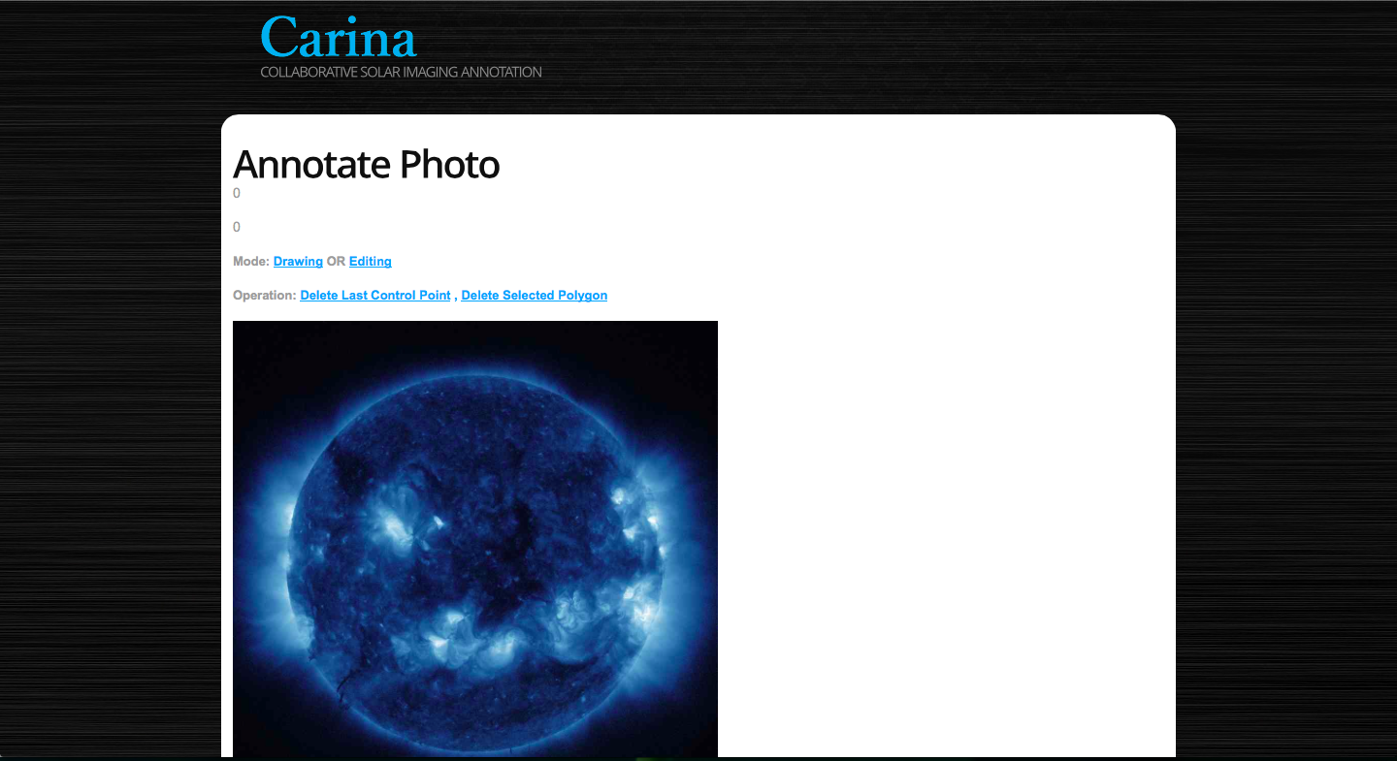
Product Functions
To annotate images users will click on screen, making waypoints that are stored in a normalized coordinate form with the top left of the image being (0,0) and the bottom right of the image being (1,1).

Slide 7
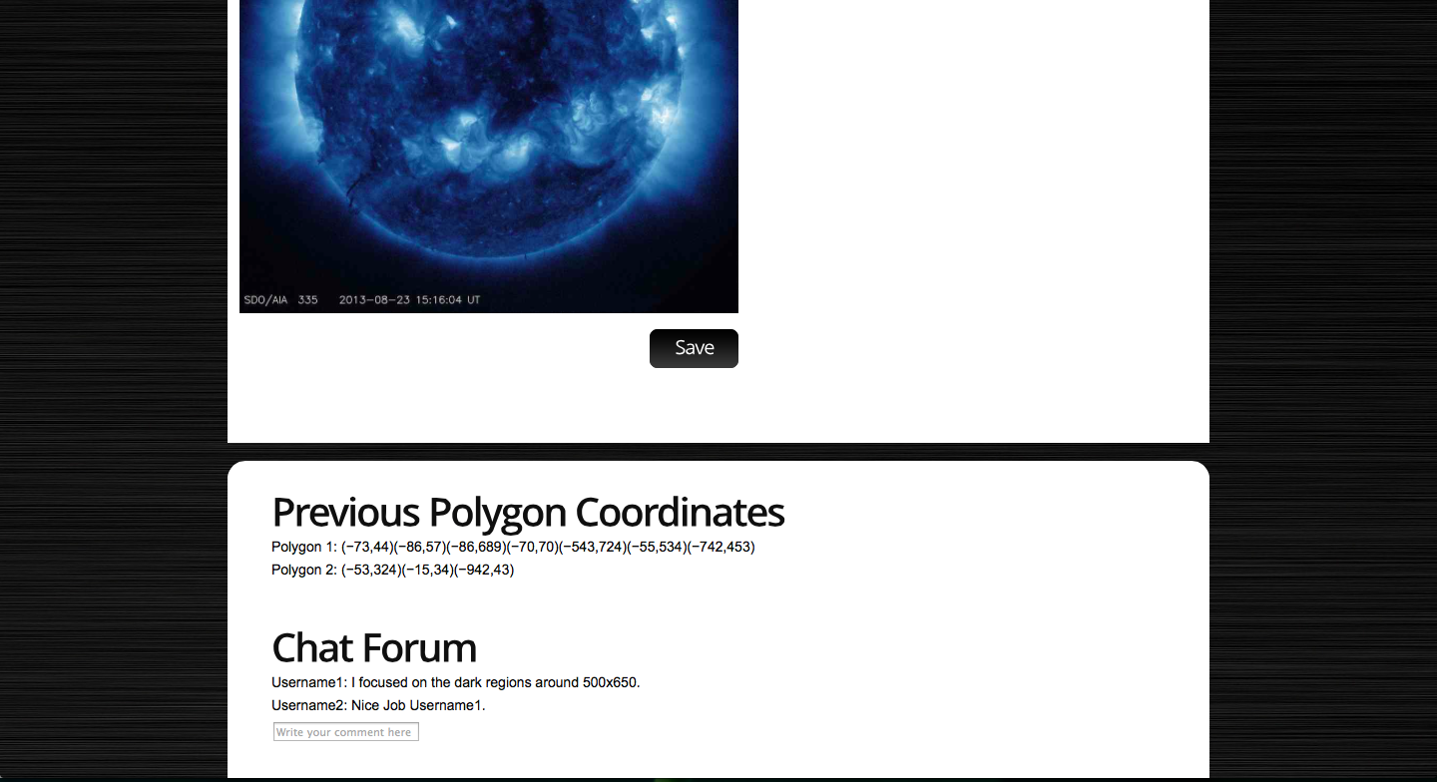
Product Functions
User will be given several collaboration and communication tools to work cooperatively with one another.

Slide 8



Multi-Platform Deployable
The CARINA web app will be available for deployment in current Mac OS X, Windows, and Linux distributions as well as be accessible through various web browsers.

Slide 9
Software Interfaces
Apache
Apache will be used by the web app as the web server running the program and providing the content to the users.
MySQL
The MySQL database will be the core of the web app. The database will store user account information, like user-names.
PHP
PHP will be used to interface between the information in the MySQL database and the HTML and JavaScript front end of the web application.

Slide 10
Software Interfaces (cont.)
HTML
HTML is the markup language that will provide the primary foundation of the web page.
JavaScript
JavaScript will be used to build the graphical front-end of the application.
CSS
CSS in conjunction with HTML and JavaScript will be used to modify the graphical front end.

Slide 11
Multi-User Interface
Determine ???

Slide 12
Multi-User Interface
Determine ???

Slide 13
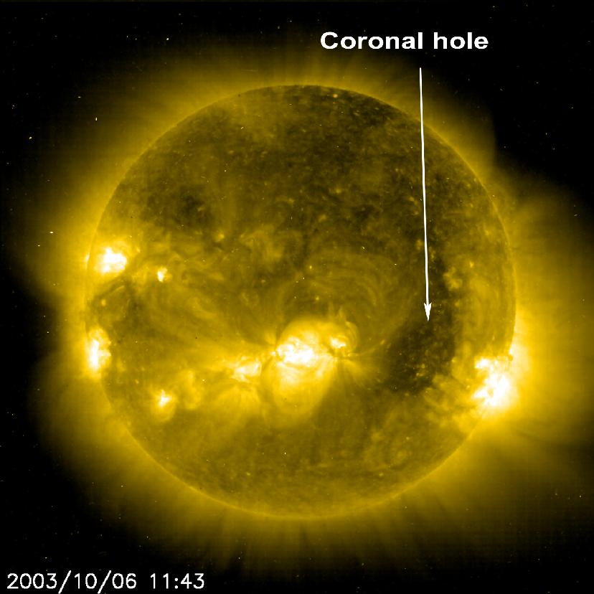
Upload Images
Users will have the capacity to upload images from their local computer to the database for annotation.
Annotated images can be saved for future work.

Slide 14
Collaboration
Determine ???

Slide 15
Project Plan
Determine functionality and features of CARINA web app
(Laid out in Functional Specification)
Create database
Design and Code Canvas functionality
Create layout and functionality of website
Combine website, database, and canvas functionality into working prototype
Upload application to ECE server
Test the functionality of the application

Slide 16

Questions?

